Slide 1



Plasma control development for JT-60SA
Presented Doménica Corona³
Alfredo Pironti^{1,2} ,N. Cruz³, G. De Tommasi^{1,2}, M. Mattei^{1,4}, A. Mele^{1,2}
¹Consorzio CREATE
²Department of Electrical Engineering and Information Technology, University of Naples Federico II, Italy
³Instituto de Plasmas e Fusão Nuclear, Instituto Superior Técnico, Universidade de Lisboa, Portugal
⁴ Dipartimento di Ingegneria Industriale e dell'Informazione, Seconda Università di Napoli

Slide 2
Contents
Proposed architecture for plasma axisymmetric magnetic control
ELM triggering using vertical kicks
Shape control using plasma-wall gaps

Slide 3
Proposal for the JT-60SA magnetic control system
A possible architecture the JT-60SA magnetic control system has been proposed, together with the control algorithms to be implemented
Preliminary simulations have been performed, mainly aimed at checking the feasibility of the proposed control approach
More details can be found in N. Cruz et al., Control Engineering Practice, 2017

Slide 4
Proposal for the JT-60SA magnetic control system
The proposed algorithm for VS has been used to assess the possibility of triggering ELMs by using vertical kicks
An isoflux approach was proposed for plasma shape control
A new gap-based plasma shape controller has been developed in 2017
Assessment of the performance is ongoing (part of the 2018 activities)
Control segments of the isoflux plasma shape controller

Slide 5
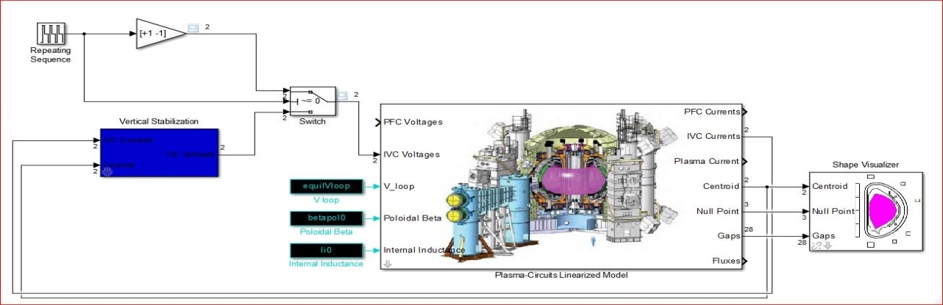
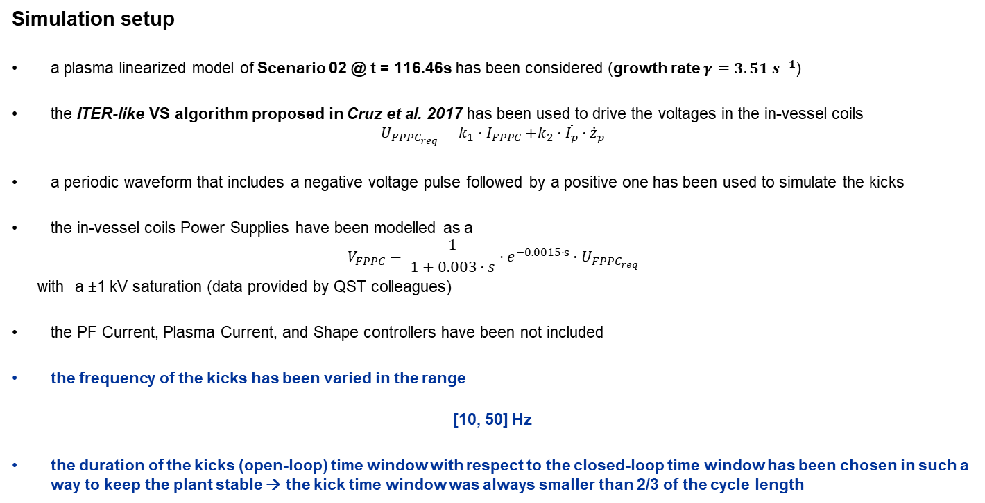
ELM triggering using VS kicks – Simulation Setup
Simulation setup
a plasma linearized model of Scenario 02 @ t = 116.46s has been considered (growth rate $γ=3.51 s^{−1}$)
the ITER-like VS algorithm proposed in Cruz et al. 2017 has been used to drive the voltages in the in-vessel coils
$$U_{FPPC_{req}}=k_{1}{⋅I}_{FPPC}+k_{2}⋅{\overline{I}}_{p}⋅{\dot{z}}_{p}$$
a periodic waveform that includes a negative voltage pulse followed by a positive one has been used to simulate the kicks
the in-vessel coils Power Supplies have been modelled as a
$$V_{FPPC}= \frac{1}{1+0.003⋅s}⋅e^{−0.0015⋅s}⋅U_{FPPC_{req}}$$
with a ±1 kV saturation (data provided by QST colleagues)
the PF Current, Plasma Current, and Shape controllers have been not included
the frequency of the kicks has been varied in the range
[10, 50] Hz
the duration of the kicks (open-loop) time window with respect to the closed-loop time window has been chosen in such a way to keep the plant stable → the kick time window was always smaller than 2/3 of the cycle length

Slide 6
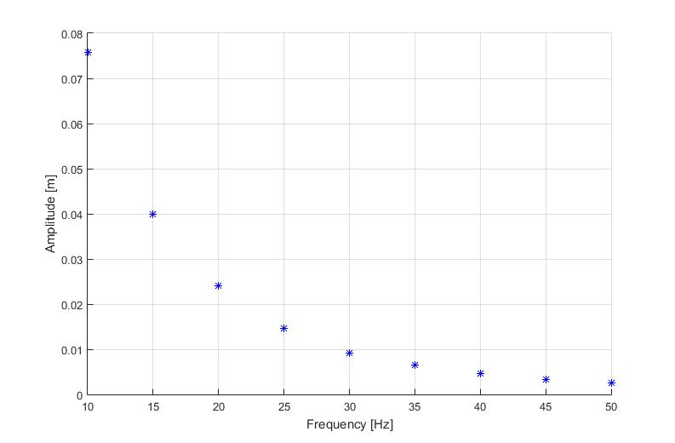
ELM triggering – Simulation results - 1
A sweep with a resolution of 5 Hz has been performed in order to estimate the maximum amplitude of the vertical movement for the plasma centroid with respect to the kicks frequency.
Given the bandwidth of the in-vessel power supplies, the maximum vertical displacement decreases with frequency → simulation results are mainly affected by the assumption on the dynamic response of the in-vessel coil power supplies
MAXIMUM VERTICAL DISPLACEMENT AS A FUNCTION OF THE KICKS FREQUENCY

Slide 7
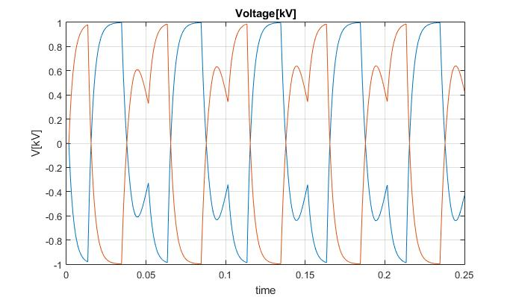
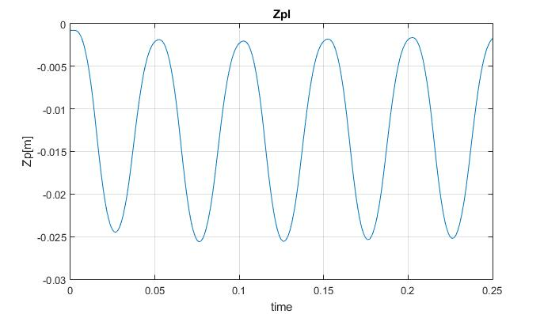
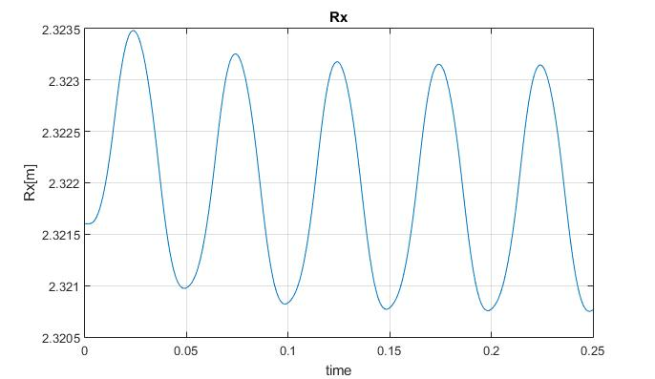
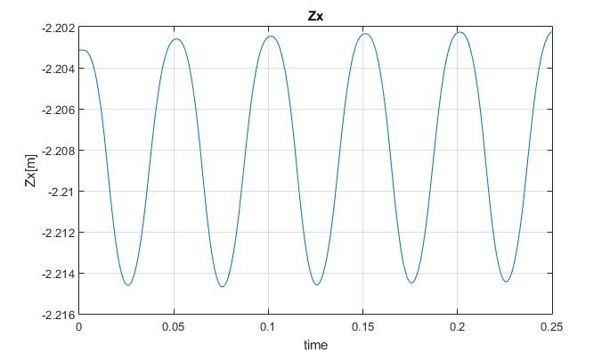
ELM triggering – Simulation results - 2
Simulation results for kicks @ 20 Hz
VOLTAGE APPLIED TO THE IN-VESSEL COILS
(POWER SUPPLIES OUTPUTS)
PLASMA CENTROID VERTICAL POSITION
X-POINT coordinates (Rx, Zx)

Slide 8
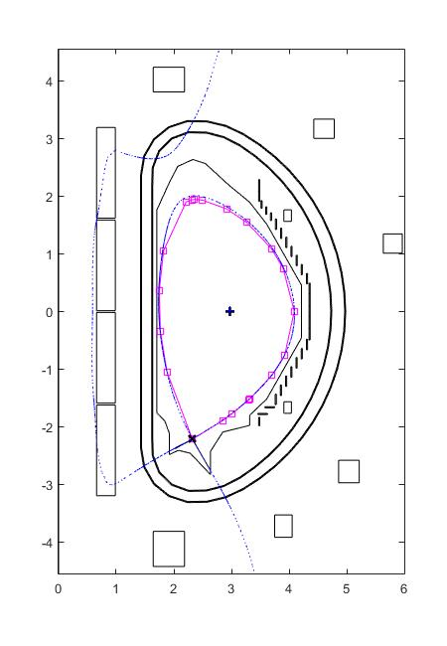
ELM triggering – Simulation results - 3
Simulation results for kicks @ 20 Hz
Comparison between the equilibrium shape (blue) and the one corresponding to the maximum centroid displacement (magenta)
Note:
shape controller was NOT included in the simulations
Given the CS/EF power supplies, the dynamic response of the plasma shape controller is slower than the kick frequency

Slide 9
Plasma shape control using plasma-wall gaps
XSC-like approach for a gap-based plasma shape controller
Reference scenario
Controlled gaps selection
Simulation results
Open issues
Proposal for 2018 activities

Slide 10
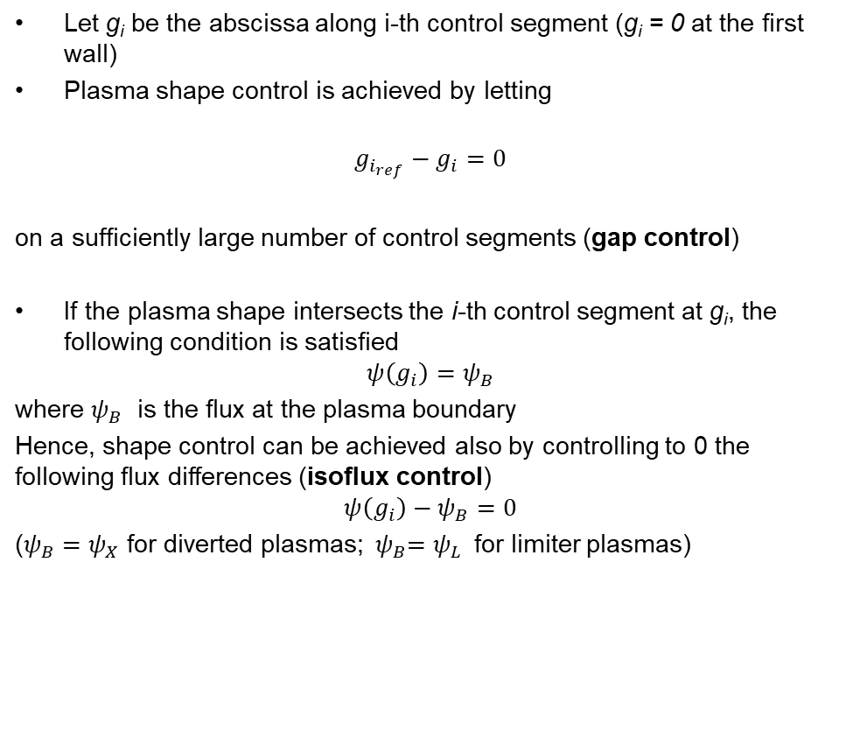
Plasma shape descriptors
Let g_{i} be the abscissa along i-th control segment (g_{i} = 0 at the ﬁrst wall)
Plasma shape control is achieved by letting
$$g_{i_{ref}}−g_{i}=0$$
on a sufﬁciently large number of control segments (gap control)
If the plasma shape intersects the i-th control segment at g_{i}, the following condition is satisﬁed
$$ψ\left(g_{i}\right)=ψ_{B}$$
where $ψ_{B}$ is the ﬂux at the plasma boundary
Hence, shape control can be achieved also by controlling to 0 the following flux differences (isoﬂux control)
$$ψ\left(g_{i}\right)−ψ_{B}=0$$
($ψ_{B}=ψ_{X}$for diverted plasmas; ${ ψ}_{B}=ψ_{L}$for limiter plasmas)

Slide 11
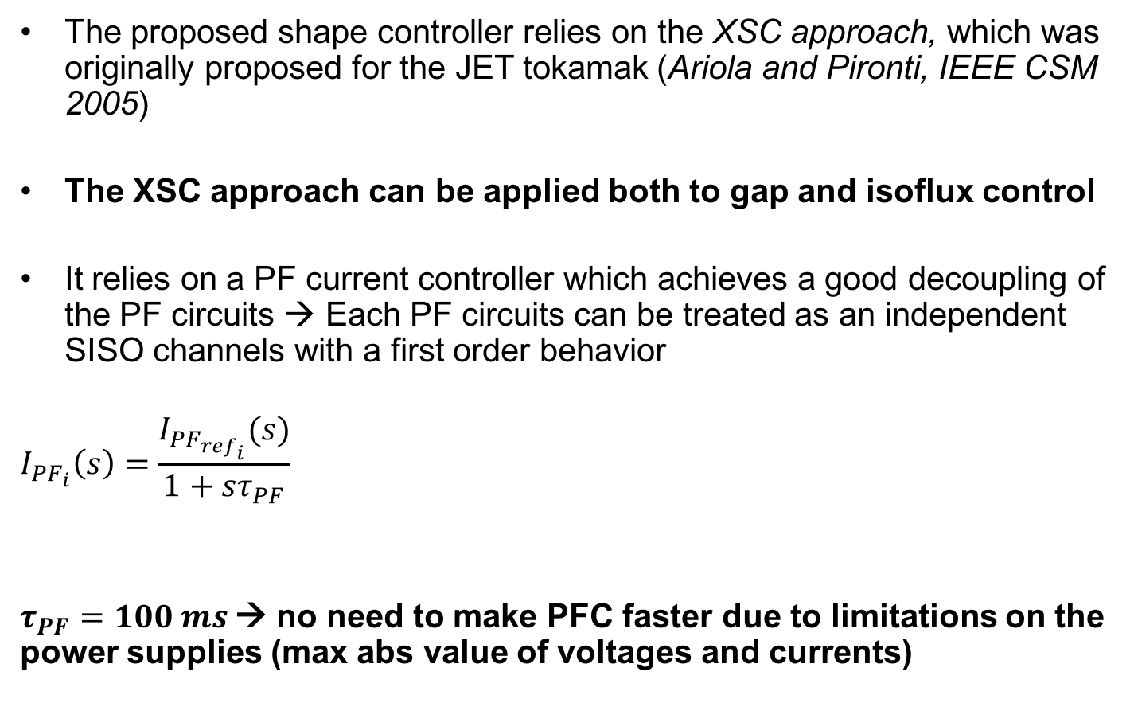
Plasma shape control
The proposed shape controller relies on the XSC approach, which was originally proposed for the JET tokamak (Ariola and Pironti, IEEE CSM 2005)
The XSC approach can be applied both to gap and isoflux control
It relies on a PF current controller which achieves a good decoupling of the PF circuits → Each PF circuits can be treated as an independent SISO channels with a first order behavior
$$I_{PF_{i}}\left(s\right)=\frac{I_{PF_{ref_{i}}}(s)}{1+sτ_{PF}}$$
$τ_{PF}=100 ms$→ no need to make PFC faster due to limitations on the power supplies (max abs value of voltages and currents)

Slide 12
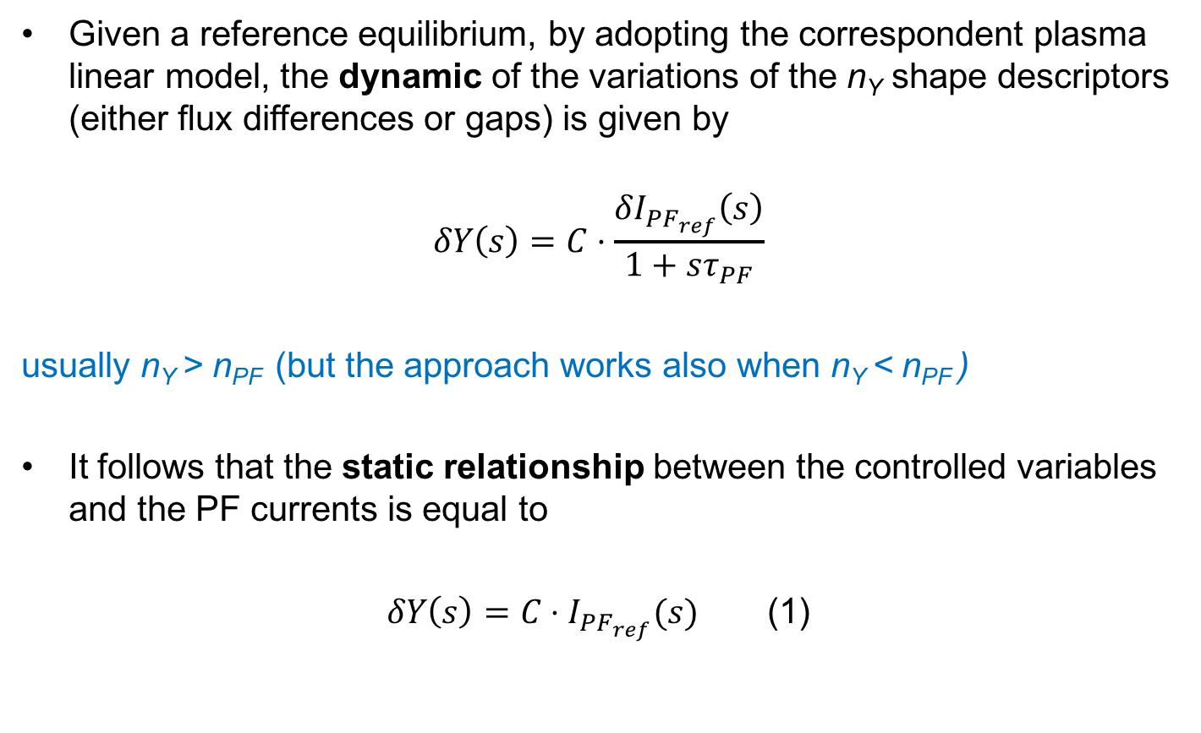
XSC contol strategy - 1
Given a reference equilibrium, by adopting the correspondent plasma linear model, the dynamic of the variations of the n_{Y} shape descriptors (either ﬂux differences or gaps) is given by
$$δY\left(s\right)=C⋅\frac{{δI}_{PF_{ref}}\left(s\right)}{1+sτ_{PF}}$$
usually n_{Y} > n_{PF} (but the approach works also when n_{Y} < n_{PF} )
It follows that the static relationship between the controlled variables and the PF currents is equal to
$δY\left(s\right)=C⋅I_{PF_{ref}}(s)$ (1)

Slide 13
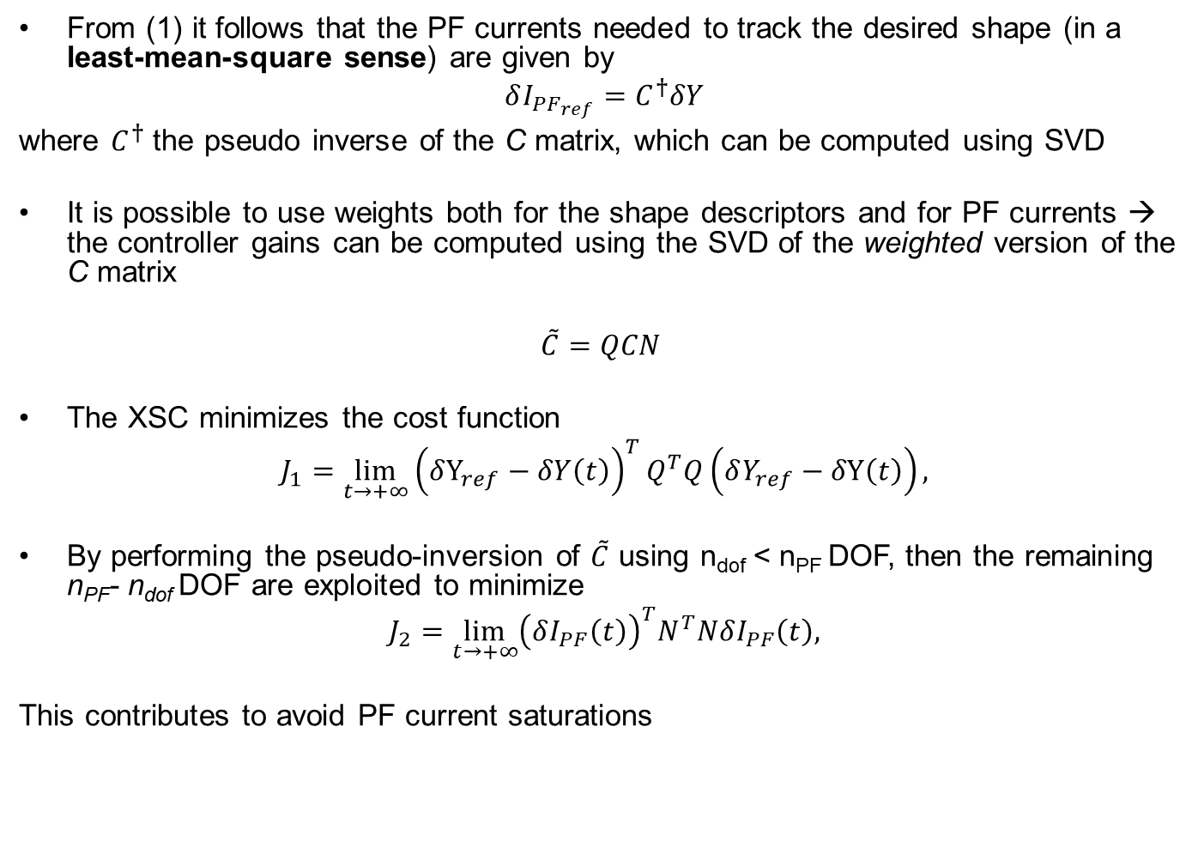
XSC contol strategy - 2
From (1) it follows that the PF currents needed to track the desired shape (in a least-mean-square sense) are given by
$$δI_{PF_{ref}}=C^{†}δY$$
where $C^{†}$ the pseudo inverse of the C matrix, which can be computed using SVD
It is possible to use weights both for the shape descriptors and for PF currents → the controller gains can be computed using the SVD of the weighted version of the C matrix
$$\tilde{C}=QCN$$
The XSC minimizes the cost function
$$J_{1}=\lim_{t→+∞}{{\left(δY_{ref}−δY\left(t\right)\right)}^{T}Q^{T}Q\left(δY_{ref}−δY\left(t\right)\right),}$$
By performing the pseudo-inversion of $\tilde{C}$ using n_{dof} < n_{PF} DOF, then the remaining n_{PF}- n_{dof} DOF are exploited to minimize
$$J_{2}=\lim_{t→+∞}{{\left(δI_{PF}\left(t\right)\right)}^{T}N^{T}NδI_{PF}\left(t\right),}$$
This contributes to avoid PF current saturations

Slide 14
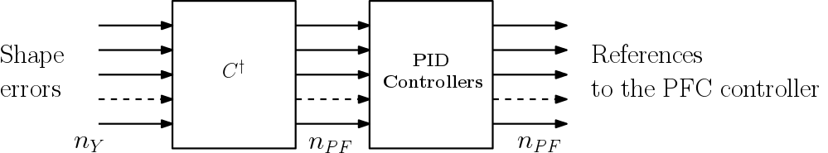
XSC block diagram
PIDs are added to improve the dynamic behavior of plasma shape control

Slide 15
Reference scenario – JT-60SA Scenario #2
JT-60SA Scenario 2 with Ip = 5.5 MA at flat-top
Plasma equilibria and correspondent linear models have been generated for different snapshots during the scenario (ramp-up, flat-top, and ramp-down)

Slide 16
Plasma shape descriptors
A set of 83 gaps + 2 strikes has been defined
Three different choices
Complete set of shape descriptors
18 equally spaced gaps + 2 strikes
4 gaps + 2 strikes (from Miyata et al., PFR 2013)
6 gaps + 2 strikes (from Miyata et al., PFR 2014)
in Miyata’s papers a isoflux approach was proposed
Complete set
(83 gaps + 2 strikes)
Miyata PFR 2013
Miyata PFR 2014
18 gaps + 2 strikes

Slide 17
Reference scenario - JT-60SA Scenario #2
The controller design has been based on the SOF equilibrium (I_{p} = 5.5 MA; β_{p} = 0.529; l_{i} = 0.853)
Disturbance (variation of β_{p} and li) for the ramp-up and start of flat top taken from
Miyata et al., PFR 2013 Urano et al., FED 2015

Slide 18
Simulation results – Disturbance rejection 1
Simulation results for both Urano and Miyata disturbance time traces
All gaps + 2 strikes
Urano
Miyata

Slide 19
Simulation results - Disturbance rejection 2
Simulation results for both Urano and Miyata disturbance time traces
18 + 2 strikes
Urano
Miyata

Slide 20
Simulation results - Disturbance rejection 3
Simulation results for both Urano and Miyata disturbance time traces
6 gaps + 2 strikes (from Miyata et al., PFR 2014)
but with gap approach (for the sake of comparison)
Urano
Miyata
Max steady state error
∼10 cm

Slide 21
Simulation results - Disturbance rejection 4
Simulation results for both Urano and Miyata disturbance time traces
4 gaps + 2 strikes (from Miyata et al., PFR 2013) but gap approach
Urano
Miyata
Max steady state error
∼5 cm

Slide 22
Simulation results – Reference tracking
Change of reference shape
Transition time = 1.0 [s]
No disturbances

Slide 23
Simulation results – Reference tracking 1
All shape descriptors
18 + 2 strikes
No practical difference between controlling 85 or 20 shape descriptors

Slide 24
Simulation results - Reference tracking 2
6 gaps + 2 strikes (from Miyata et al., PFR 2014)

Slide 25
Simulation results - Reference tracking 3
4 gaps + 2 strikes (from Miyata et al., PFR 2014)

Slide 26
Simulation results – RMSE
Root mean square error compute on the overall shape (85 shape descriptors)

Slide 27
Discussion issues
An analysis of the steady-state performance for different choices for the controlled shape descriptors has been performed
The dynamic behavior of the shape controller (but also of the I_{p} controller) seems to be affected by the performance of the PF power supplies
A larger set of possible disturbances (in terms of β_{p} and l_{i} variations) would be useful to better assess the dynamic performance such as
Minor disruption
H-L transition
ELM
…
Have Miyata’s disturbances been validated in EU?

Slide 28
Proposal for 2018 activities
Design an isoflux shape controller for limiter plasmas
Controller validation with linear models
Nonlinear simulation of the limiter-diverted transition for Scenario #2
Paper at SOFT

Slide 29
Backup - slides
BACKUP SLIDES

Slide 30
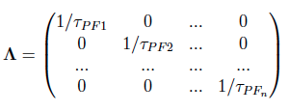
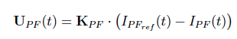
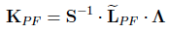
PFC current controller
The design of the proposed PFC current control is based on a plasmaless model
The following design approach already proposed for ITER tokamak has been adopted:
A modified version of the inductance matrix is calculated, by neglecting the effect of the passive structures and by
In order to minimize the control effort, for each circuit all the mutual inductances which are less than 10% of the circuit self-inductance have been neglected → in this way the current in each circuit is controlled only by those circuits who are more coupled with it
The time constants are used to define the matrix
The controller is then given by
where

